Slide 1
Lecture 10
AO Control Theory
Claire Max
with thanks to Don Gavel and Don Wiberg
UC Santa Cruz
February 18, 2016

Slide 2
What are control systems?
Control is the process of making a system variable adhere to a particular value, called the reference value.
A system designed to follow a changing reference is called tracking control or servo.

Slide 3
Outline of topics
What is control?
  The concept of closed loop feedback control
A basic tool: the Laplace transform
  Using the Laplace transform to characterize the time and frequency domain behavior of a system
  Manipulating Transfer functions to analyze systems
How to predict performance of the controller

Slide 5
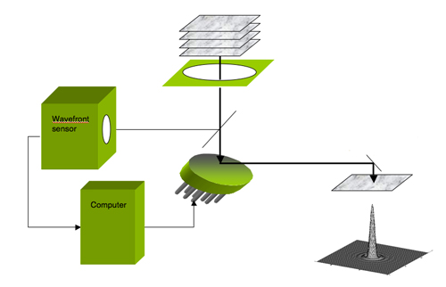
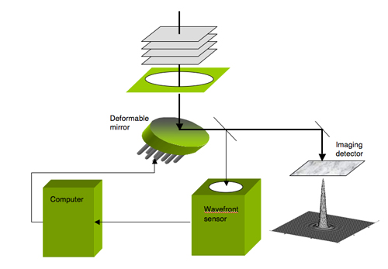
Differences between open-loop and closed-loop control systems
Open-loop: control system uses no knowledge of the output
Closed-loop: the control action is dependent on the output in some way
“Feedback” is what distinguishes open from closed loop
What other examples can you think of?
OPEN
CLOSED
Notes:
Open: automatic toaster (timer), photocell that turns on lights at dusk and off at dawn
Closed: cruise control, airplane autopilot, toilet bowl filling up
Either: an electric clothes dryer (“auto” cycle or timed cycle)

Slide 6
More about open-loop systems
Need to be carefully calibrated ahead of time:
Example: for a deformable mirror, need to know exactly what shape the mirror will have if the n actuators are each driven with a voltage V_{n}
Question: how might you go about this calibration?
OPEN

Slide 7
Some Characteristics of Closed- Loop Feedback Control
Increased accuracy (gets to the desired final position more accurately because small residual errors will get corrected on subsequent measurement cycles)
Less sensitivity to nonlinearities (e.g. hysteresis in the deformable mirror) because the system is always making small corrections to get to the right place
Reduced sensitivity to noise in the input signal
BUT: can be unstable under some circumstances
(e.g. if gain is too high)

Slide 8
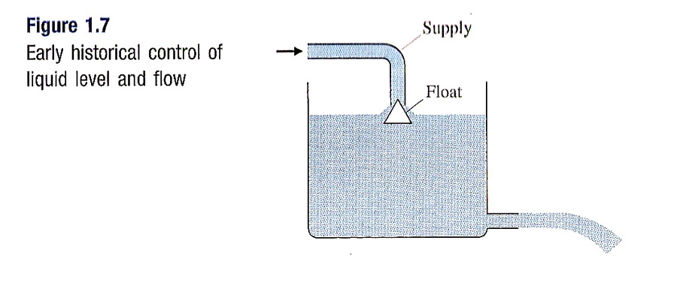
Historical control systems: float valve
Credit: Franklin, Powell, Emami-Naeini
As liquid level falls, so does float, allowing more liquid to flow into tank
As liquid level rises, flow is reduced and, if needed, cut off entirely
Sensor and actuator are both “contained” in the combination of the float and supply tube

Slide 9
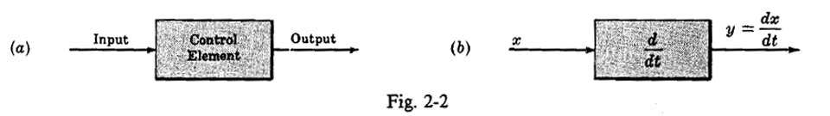
Block Diagrams: Show Cause and Effect
Credit: DiStefano et al. 1990
Pictorial representation of cause and effect
Interior of block shows how the input and output are related.
Example (b) output is the time derivative of the input

Slide 10
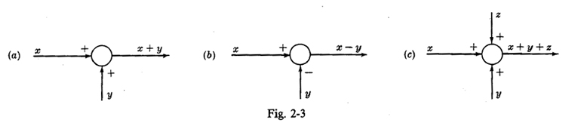
“Summing” Block Diagrams are circles
X
Credit: DiStefano et al. 1990
Block becomes a circle or “summing point”
Plus and minus signs indicate addition or subtraction (note that “sum” can include subtraction)
Arrows show inputs and outputs as before
Sometimes there is a cross in the circle

Slide 11
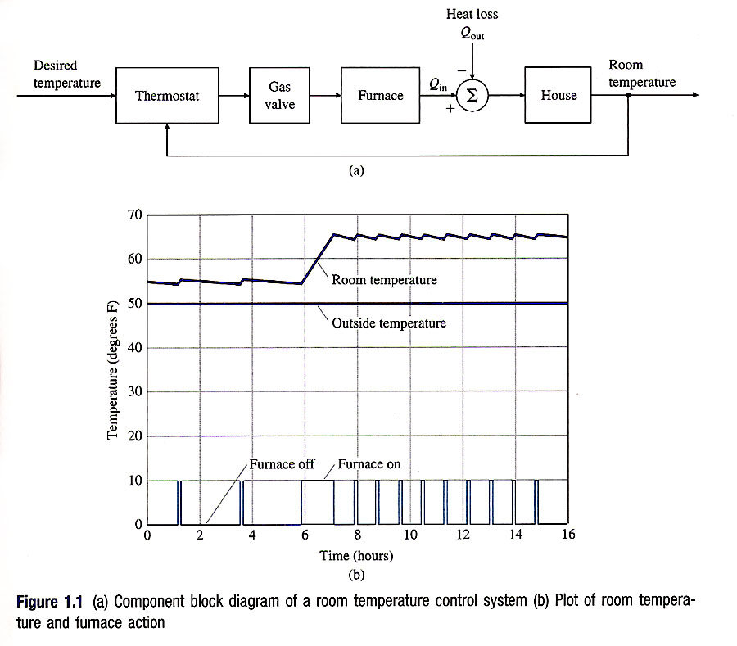
A home thermostat from a control theory point of view
Credit: Franklin, Powell, Emami-Naeini

Slide 12
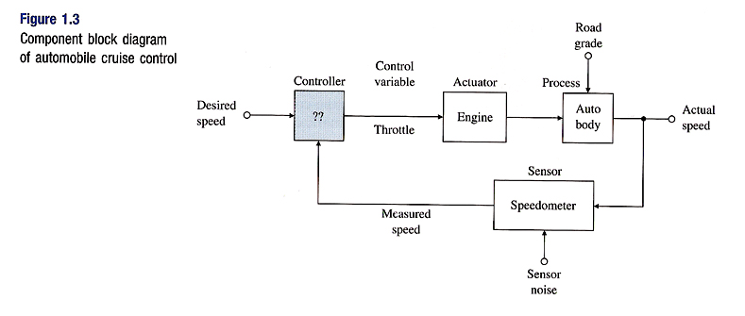
Block diagram for an automobile cruise control
Credit: Franklin, Powell, Emami-Naeini

Slide 13
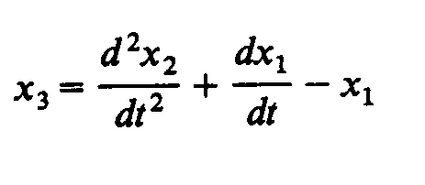
Example 1
Draw a block diagram for the equation

Slide 14
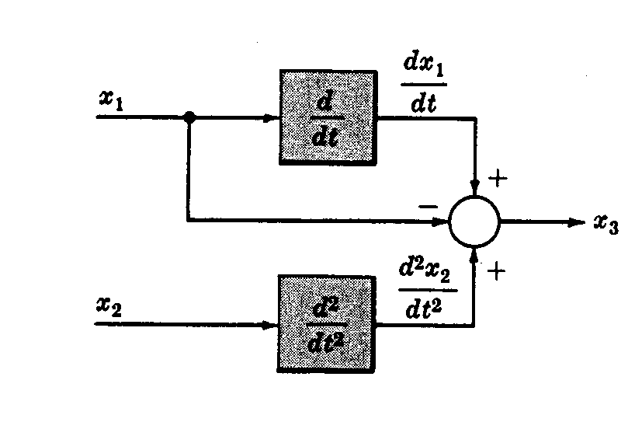
Example 1
Draw a block diagram for the equation
Credit: DiStefano et al. 1990

Slide 15
Example 2
Draw a block diagram for how your eyes and brain help regulate the direction in which you are walking
Notes:
Is this open loop or closed loop?

Slide 16
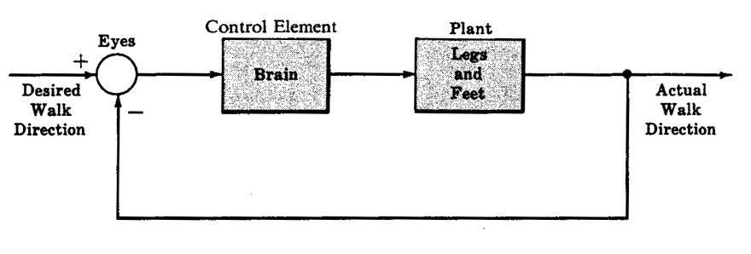
Example 2
Draw a block diagram for how your eyes and brain help regulate the direction in which you are walking
Credit: DiStefano et al. 1990
Notes:
Is this open loop or closed loop?

Slide 17
Summary so far
Distinction between open loop and closed loop
  Advantages and disadvantages of each
Block diagrams for control systems
  Inputs, outputs, operations
  Closed loop vs. open loop block diagrams

Slide 18
The Laplace Transform Pair
Similar in some ways to Fourier Transform, but for initial value problems where you want to see the time evolution
By contrast, Fourier Transform deal with periodic systems

Slide 19
Laplace Transform Pairs
h(t)
H(s)
1
unit step
0
t
delayed step
0
T
t
unit pulse
0
T
t

Slide 20
Laplace Transform Properties
Linearity
Time-shift
Dirac delta function transform
(“sifting” property)
Convolution
Impulse response
Frequency response

Slide 21
System Block Diagrams
Time domain
Frequency domain
x(t)
y(t)
X(s)
Y(s)
h(t)
H(s)
Convolution of input x(t) with impulse response h(t)
Product of input spectrum X(s) with frequency response H(s)
H(s) in this role is called the transfer function

Slide 22
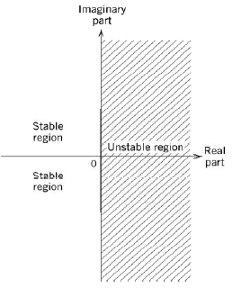
Control Loop Arithmetic
W(s)
+
A(s)
input
output
Y(s)
-
B(s)
Unstable if any roots of
1+A(s)B(s) = 0
are in right-half of the s-plane: exponential growth

Slide 23
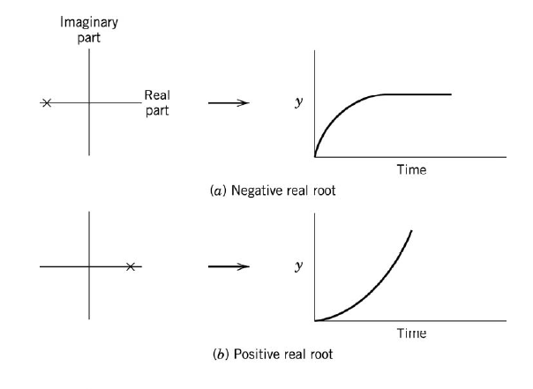
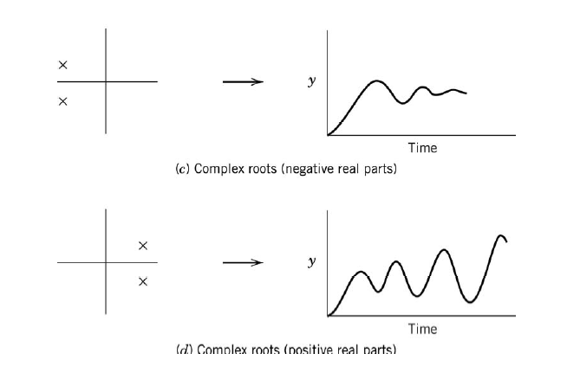
Stable and unstable behavior
Stable
Stable
Unstable
Unstable

Slide 24
Closed loop control (simple example, H(s)=1)
W(s)
X(s)
disturbance
+
residual
E(s)
-
Y(s)
correction
gC(s)
Where g is the “gain” and C is the control law
Our goal will be to suppress X(s) (residual) by high-gain feedback so that Y(s)~W(s)
solving for E(s),
Note: for consistency “around the loop,” the units of the gain g must be the inverse of the units of C(s).

Slide 25
The integrator, one choice for C(s)
A system whose impulse response is the unit step
0
t
acts as an integrator to the input signal:
x(t)
y(t)
c(t)
c(t-t’)
x(t’)
t
t’
0
that is, C(s) integrates the past history of inputs, x(t)

Slide 26
The Integrator, continued
In Laplace terminology:
X(s)
Y(s)
C(s)
An integrator has high gain at low frequencies, low gain at high frequencies.
Write the input/output transfer function for an integrator in closed loop:
The closed loop transfer function with the integrator in the feedback loop is:
W(s)
+
X(s)
W(s)
X(s)
-
H_{CL}(s)
Y(s)
gC(s)
closed loop transfer function
output (e.g. residual wavefront to science camera)
input disturbance (e.g. atmospheric wavefront)

Slide 27
The integrator in closed loop (1)
H_{CL}(s), viewed as a sinusoidal response filter:
DC response = 0
(“Type-0” behavior)
High-pass behavior
and the “break” frequency (transition from low freq to high freq behavior) is around σ ~ g

Slide 28
The integrator in closed loop (2)
The break frequency is often called the “half-power” frequency
1
1/2
g
σ
(log-log scale)
Note that the gain, g, is the bandwidth of the controller:
  Frequencies below g are rejected, frequencies above γ are passed.
  By convention, g is known as the gain-bandwidth product.

Slide 29
Controller: element whose role is to maintain a physical quantity in a desired level.
Compensator : modification of system dynamics, to improve characteristics of the open-loop system so that it can safely be used with feedback control.

Slide 31
Assume that residual wavefront error is introduced by only two sources
Failure to completely cancel atmospheric phase distortion
Measurement noise in the wavefront sensor
Optimize the controller for best overall performance by varying design parameters such as gain and sample rate

Slide 37
What we have learned
Pros and cons of feedback control systems
The use of the Laplace transform to help characterize closed loop behavior
How to predict the performance of the adaptive optics under various conditions of atmospheric seeing and measurement signal-to-noise
A bit about loop stability, compensators, and other good stuff

